Slide 1
Data Reduction Overview
Xinyue Ou
2017/03/06

Slide 2
Data Reduction
Can be divided into three categories
dimension reduction
sample numerosity reduction
cardinality reduction

Slide 3
Data Reduction
Why?
The curse of dimensionality, especially for non-parametric methods
How?
linear method: PCA, factor analysis
nonlinear method: locally linear embedding (LLE)
feature selection

Slide 4
PCA
Basic idea
linear transformation of original variables
the eigenvector with large eigenvalues carry the main info
new set of attributes are form
Steps
normalize the data and compute the covariance
decompose the covariance and reduce the dimension
apply transformation on original data
Remark
especially useful when the features are highly correlated and redundant

Slide 5
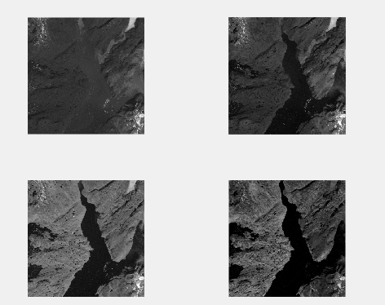
PCA

Slide 6
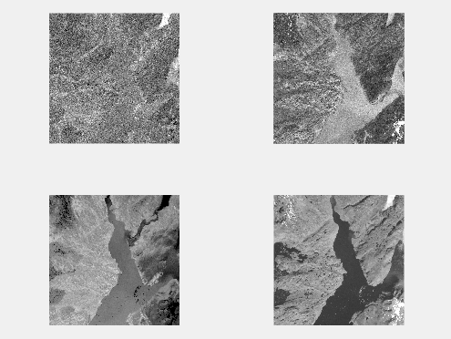
PCA

Slide 7
LLE
Basic idea
Assume that data are locally linear. Each point can be revcovered by its neightbor. It preserve the invariance to rotation and scaling.
Find the low dimension coordinates by minimizing the error constructed with the weights of neighbors
Remark
can lower to any dimension
but require data has linear locality

Slide 8
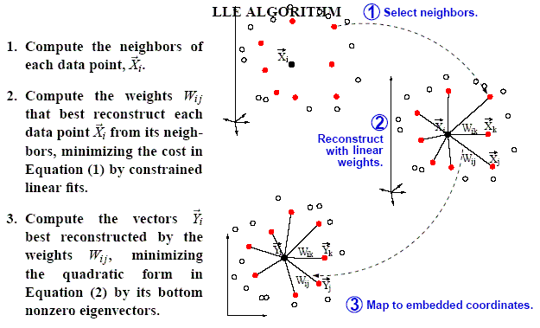
LLE

Slide 9
Feature Selection
Feature relevance
In terms of an ideal Bayes classifier
strongly relevant if remove the feature X will result in the deterioration of the classification results
weakly relevant if there exisits a set S that performance is better when using S U {X} than S.
irrelevant if neither weakly or strong relevant

Slide 10
Feature Selection
Feature selection method
Filter method
chi-Sqaured: univariate, the higher teh chi-squared, the more relkevant the feature with respect to the class.
information gain: entorpy orginal - entropy posterior
Correlation-Based Feature Selection.: multivariate, the more the fetaure related with the class and the less with the orther feature, the more it is selected.
ReliefF: improved version of Relief algorithm. The attributes that separate the same class is insignificant and the attributes that separate different calsses is desirable.

Slide 11
RelieF
Rationale
Features that separate different class has high weights, and separate the same class should get low weights.
randomly selecting an instance Ri from the data and then locating its k nearest neighbors from the same (nearest hits, Hj) class and k nearest neighbors from each one of the other different classes, nearest misses Mj(C).

